Slide 1

DoorDash Design Sprint
Automated Food Delivery with Self-Driving Cars.
Product Manager: Jamil Abdulai
© 2019 Udacity. All rights reserved.

Slide 2
Set the stage
Set the stage for the Design Sprint by framing the problem
© 2019 Udacity. All rights reserved.
Notes:
[ALL PARTICIPATION]

Slide 3
Initial PRD
Background
The rise of online ordering utilizations and food deliveries over the years have drastically skyrocketed. Over the years, the emergence of food delivery services have been adopted by many businesses with a conscious deliberate efforts to improve delivery time, reduce operations costs and increase customer satisfaction.
Problem
With the demand for an improved customer satisfaction across multiple facets of businesses, our objective at DoorDash is not just to satisfy the customer but amaze them. The operational costs and fees charged per delivery by businesses to dashers must be drastically cut down hence the birth of the autonomous delivery cars. The short-term goal is to design a robot capable of making deliveries within a two-mile radius with the capabilities to view status of deliveries and remotely take control of robots that need intervention (i.e rerouting) whereas the human dashers focus on radius over two miles.

Slide 4
Initial PRD
Goals
Build an autonomous delivery robot that deliver services to customers within a two-mile radius.
Drastically reduce operational costs and fees associated with using human dashers.
Increase customer satisfaction through the prioritization of prompt deliveries of services.
Build capabilities to view status of deliveries and remotely take control of robots that need intervention.

Slide 5
Understand
Create a shared understanding of the space, problem, and goals
© 2019 Udacity. All rights reserved.
Notes:
[ALL PARTICIPATION]

Slide 6
How Might We
How might we mitigate accidents between robots and pedestrians?
How might we confirm that the robot is at the right address?
How might we program robots to address delays in deliveries?
How might we make robots not scary for dogs?
How might we address a sudden power outage?
How might we keep robots odor free, even when carrying smelly food?
How might we control robots?
How might we make routes more efficient?
How might we teach robots to avoid obstacles?
How might we move robots to a safe place before stopping?
How might we have robots signal distress when something goes wrong?
How might we make our robots tamperproof?
How might we anticipate mechanical failures?
How might we track each robot?
How might we allow robots to detect real-time traffic patterns?
How might we establish preferred routes?
How might we see real-time traffic on the route?
How might we teach robots to avoid trouble?
How might we keep vermin away from the robots?
How might we determine when to recharge robot batteries?
How might we monitor robot progress?

Slide 7
How Might We
How might we share robot progress with consumers?
How might we enable robots to detect missing items in the order during pickup?
How might we overcome technical glitches during a delivery?
How might we handle edge case issues that may arise?
How might we build redundancy into our system?
How might we communicate with humans around the robot?
How might we prepare robot to handle deliveries to persons with disabilities?
How might we enable robots to interpret and speak different languages?
How might we allow users to help us with tracking and feedback?
How might we program robots to address customer returns?
How might we alert operators of need for robot intervention conveniently?
How might we get food to people quickly when the robot fails?
How might we deal with accidents that might occur?
How might we help robots talk to people?
How might we teach robots manners?
How might we teach users to interact with humans?
How might we alert consumers if their delivery is delayed?
How might we program robots to address order cancellations?
How might we ensure food gets delivered without incident?
How might we detect when a robot needs help?
How might we give robots a personality?
How might we make our robots act like people?
How might we teach empathy to robots?
How might we enable “emotion” modes in robots?

Slide 8
How Might We
How might we have robots entertain customers at delivery?
How might we make interacting with robots more fun?
How might we use robots to make people excited about our brand?

Slide 9
Routing and delivery
How might we mitigate accidents between robots and pedestrians?
How might we confirm that the robot is at the right address?
How might we teach robots to avoid trouble?
How might we make robots not scary for dogs?
How might we keep vermin away from the robots?
How might we program robots to address delays in deliveries?
How might we make routes more efficient?
How might we teach robots to avoid obstacles?
How might we move robots to a safe place before stopping?
How might we have robots signal distress when something goes wrong?
How might we make our robots tamperproof?
How might we allow robots to detect real-time traffic patterns?
How might we establish preferred routes?
How might we see real-time traffic on the route?
Issues on route
Environmental Factors
Routing

Slide 10
How might we alert operators of need for robot intervention conveniently?
How might we handle edge case issues that may arise?
How might we deal with accidents that might occur?
When things go wrong
How might we share robot progress with consumers?
How might we enable robots to detect missing items in the order during pickup?
How might we overcome technical glitches during a delivery?
How might we ensure food gets delivered without incident?
How might we get food to people quickly when the robot fails?
How might we address a sudden power outage?
How might we keep robots odor free, even when carrying smelly food?
How might we allow users to help us with tracking and feedback?
How might we program robots to address customer returns?
How might we detect when a robot needs help?
How might we build redundancy into our system?
How might we determine when to recharge robot batteries?
How might we anticipate mechanical failures?
How might we alert consumers if their delivery is delayed?
How might we program robots to address order cancellations?
Incident Prevention and Recovery
How might we control robots?
How might we track each robot?
How might we monitor robot progress?
Maintenance and mechanical issues
Delays, Missing Items, and Cancellations
Tracking and Remote Control

Slide 11
Human/Robot Interaction
How might we prepare robot to handle deliveries to persons with disabilities?
How might we enable robots to interpret and speak different languages?
How might we have robots entertain customers at delivery?
How might we give robots a personality?
How might we help robots talk to people?
How might we communicate with humans around the robot?
Deliveries for everyone
How might we use robots to make people excited about our brand?
How might we make interacting with robots more fun?
How might we teach users to interact with humans?
How might we teach robots manners?
How might we make our robots act like people?
How might we teach empathy to robots?
How might we enable “emotion” modes in robots?
Delight
Communication with people
Human-like

Slide 12
Sprint Focus
Focus | Routing and Delivery
Slide # | 14
I selected this theme because | This theme was chosen because it underlines the primary focus of the definition of success. The fundamental objective is to accurately route and deliver the goods and services and regardless of how great the other themes span out, they’re all futile if the main focus isn’t achieved. Tasks like confirmation of delivery, avoidance of accidents between pedestriants and robots, efficiency, safety, and use of safe traveling routes are all fundamental to the product’s success.

Slide 13
Define
With an understanding of the problem space, create focus and align on specific outcomes for the Design Sprint
Notes:
[ALL PARTICIPATION]

Slide 14
DoorDash Robotic Delivery ‘RoboDash’ by Jamil Abdulai
Food delivery services are patronized worldwide lately. The desire to ensure products and services are delivered promptly and at reasonable prices is a top priory for busy workers, millennials, and anyone with the intention of saving money. Over the years, operational costs and fees paid by businesses utilizing food delivery services have skyrocketed and won’t stop any time soon. With the constant questions asked daily: How do we reduce the cost plight? How do we increase customer satisfaction by prompt delivery of goods and services when and where they need them?
Look no further, the era of rendering amazing customer service is here! With the advancement and innovation in artificial intelligence and robotics, meet RoboDash, the world’s most optimized food delivery service is here to revamp your satisfaction. The RoboDash will solve all your delivery service needs at an affordable price with its ecofriendly abilities and dynamic capabilities. The RoboDash wants you to enjoy your amazing goods and services wherever and whenever!

Slide 15
Success Metrics
Set at least two user-centered goals
Identify changes in user behavior will signal success in reaching the goal
Create a metric to measure each signal
 | Goals | Signals | Metrics
Happiness | Deliver food promptly Price of service | Waiting for delivery How often service is used | Average wait time Amount saved from service
Engagement | Opt for robotic delivery service App download | Choose service at checkout Dashboard metric (number of apps downloaded monthly) | Percentage of customers and businesses using service monthly Number of downloads
Adoption | Share with friends and families Marketing | Refer friends and families Social media engagement | Number of referral sign ups. Number of views, likes, click through rates
Retention | Automatic use of service at checkout Interactions with customers | Choose auto-service Push notification/in-app messing | % of customers with auto-service Click through rate, open rates
Task Success | Navigate route success Customer/business used to service | Robotic reaching destination timely Customers having all doubts answered. | % of successful navigation % of customer engagement

Slide 16
Sketch
Generate tons of ideas, then narrow them down to two in depth solution sketches
Notes:
[ALL PARTICIPATION]

Slide 17
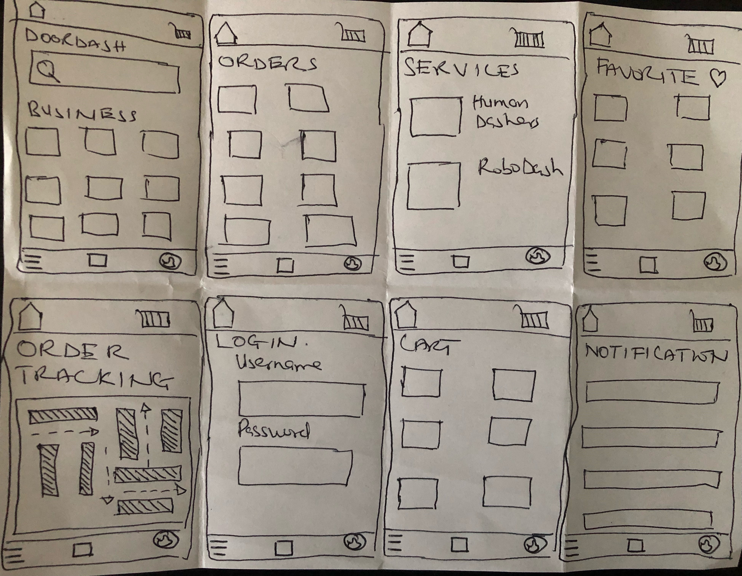
8 Sketches
Photo of your 8 sketches here

Slide 18
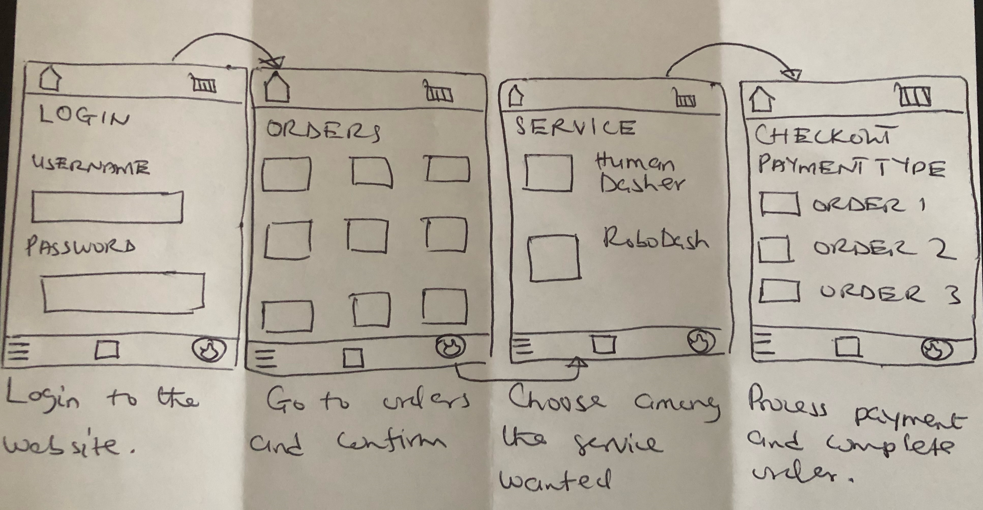
SERVICES OFFERED
Upload a photo of your sketch on this slide

Slide 19
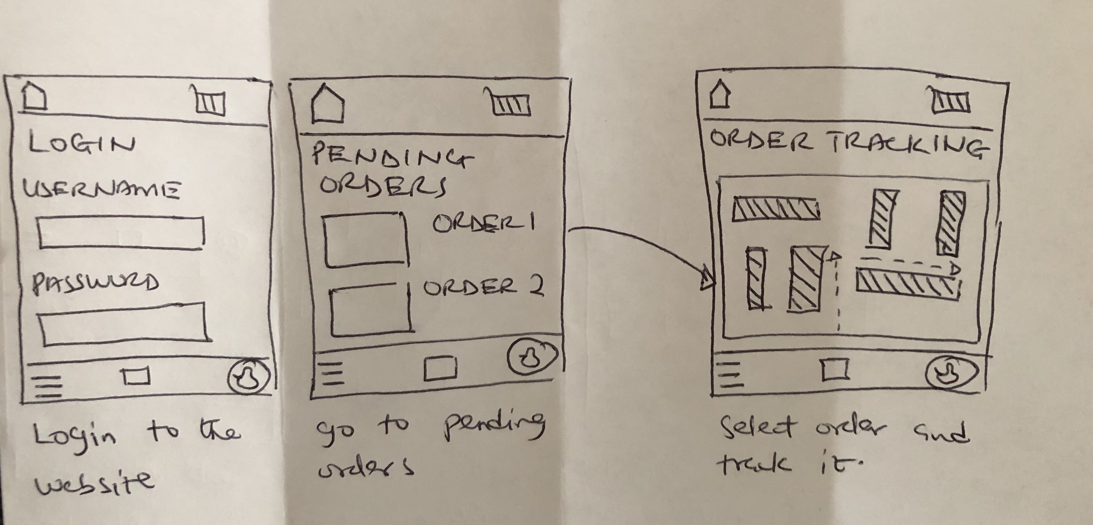
ORDER TRACKING
Upload a photo of your sketch on this slide

Slide 20
Decide
Pick the final concept that you develop into a prototype
Notes:
[ALL PARTICIPATION]

Slide 21
Decision
Decision | Order tracking sketch
Rationale | The objective is the introduction of a new robotic delivery method that is cheaper and reliable. For that to be achieved, the customer ought to be undoubtedly comfortable with the service rendered hence has to be able to track their order from its infancy to the destination.

Slide 22
Prototype
Turn your concept into a realistic, interactive prototype that you will use to validate your assumptions and ideas
Notes:
[ALL PARTICIPATION]

Slide 23







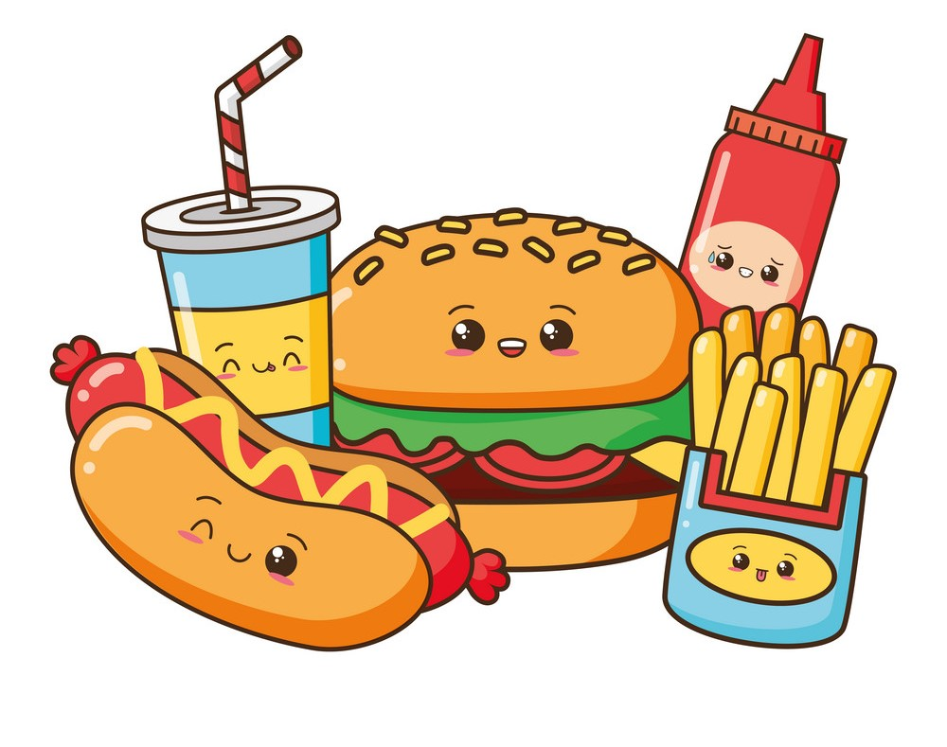
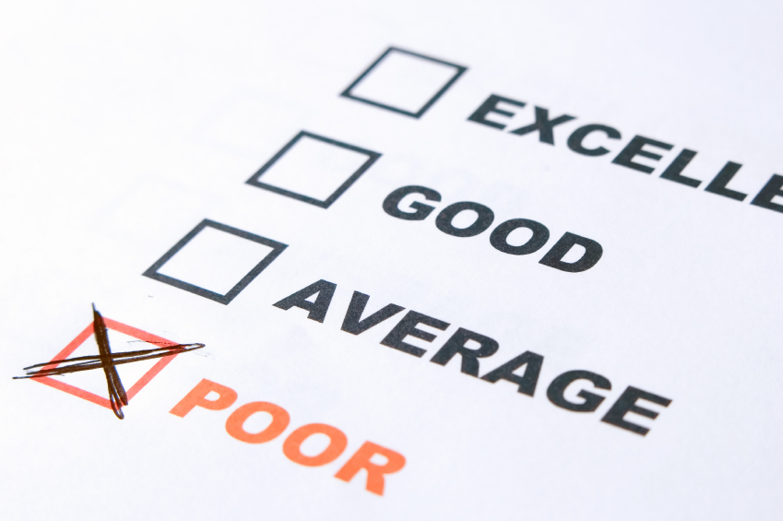
Storyboard
Dave, a full-time student and working professional is fascinated about using multiple means to balance hid busy schedule | Due to his busy schedule, he likes to use online services to order food to make his days more profitable. | Unfortunately, irrespective of the online services provided, poor customer services are significantly high due to high operation fees, tips and occasional delays in deliveries.

Slide 24


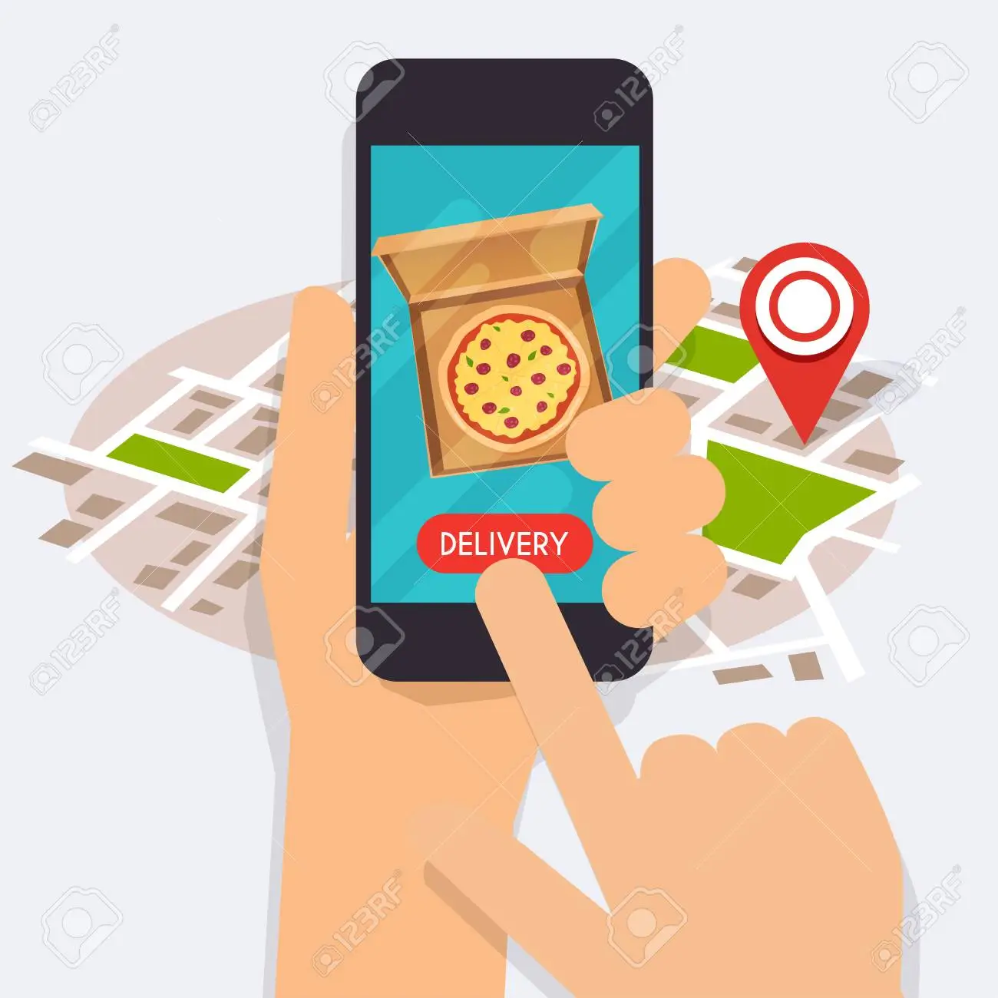



He was introduced by his roommate to the new online food delivery service provided by DoorDash where food is delivered within a two-mile radius at an affordable price by robotic vehicles, RoboDash, with a 100% on-time delivery guarantee. | Dave is fascinated by the idea and decides to download the app, sign up, and tries for himself since he lives within a 2-mile radius of most food businesses. | He tries the service and is amazed at how time-saving and excellent customer service is provided. Dave further decides to add the RoboDash as an automated continued service.

Slide 25

Prototype
Description High level overview of the prototype What does it do? | The prototype demonstrates an overview of fundamental process of utilizing an autonomous robotic vehicle to deliver food for a customer from registration to delivery of product.
Assumptions Any assumptions within the prototype | The autonomous vehicle will be able to deliver accurately with a 2-mile radius. The robot should be able to interact accurately within its surroundings and make intelligent decisions through written algorithms. Promotions will be incorporated to deliver an increased customer base.
Tasks What are the tasks that a user can complete in the prototype? | The user can accurately track the location of the autonomous vehicle through GPS on their devices. Users can save money using the autonomous vehicle in comparison to hum dashers.
Link your prototype

Slide 26
Validate
Users will go through your prototype and provide feedback on your concept. This is also an opportunity to have an engineering feasibility discussion
Notes:
[ALL PARTICIPATION]

Slide 27
DoorDash Design Sprint Research Plan
PM: JAMIL ABDULAI
STATUS: DRAFT
Objectives
Will the user be able to accurately navigate through the entire delivery process?
Will the user feel comfortable interacting with autonomous vehicle instead of human?
Will the customer feel saving money with robotic deliveries is a better option?
Methodology
The session will be conducted through videos with scenarios and storytelling. The test person will be filmed and have sheets with tasks.
Participants
The participants will be students and busy professionals.

Slide 28
DoorDash Design Sprint Research Plan: Interview Sessions
Introduction
My name is Jamil and I work as a Product Manager at DoorDash. We've been experimenting on some intriguing innovations for user experience in food delivery service and we'd want to share them with you and request your opinion. This session will proceed as follows: I will ask you a few background questions to get to know you better and show you a prototype that the team has been working on with the objective of getting feedback from you. Please study and sign this NDA before we begin. It's essential that the information we provide you and the concepts discussed today remain anonymous. Do you have any questions before we get started? Great! Is it acceptable if I record this meeting? We will solely utilize the recording internally to review our conversation. Also, please communicate with us any queries you encounter .

Slide 29
DoorDash Design Sprint Research Plan: Interview Sessions
Background Questions
Can you tell us a little about yourself?
How long have you lived in the City?
Have you ever used food delivery service with DoorDash? If yes, why and if no, why not?
Have you ever worked for a food delivery company ?
Have you tried the services provided with the delivery options (both RoboDash and HumanDash)?
How much do you spend on food delivery monthly?
How much fees do you pay per order?
Are you confident with latest trends and technologies out there?
Do you live close to most food businesses?
How did you like DoorDash services when you used it?
What was the wait time for your last order ?

Slide 30
DoorDash Design Sprint Research Plan: Interview Sessions
Tasks
I'll show you a prototype that the group has been working on right now. Remember, this is not a test. There is also no right or incorrect response. We want to know how well this concept works for you. Additionally, as it's a prototype, not all the features of the app may function. I'll want you to think out aloud as you begin utilizing the prototype and communicate with me on what you see on the screen, how you interpret it, and what you anticipate happening next. So, shall we begin?

Slide 31
DoorDash Design Sprint Research Plan: Interview Sessions
Task 1
Can you explore the app and tell us what you see?
Can you sign up and login into the page?
Can you accurately navigate the app?
Task 2
Can you describe what you see on the service page?
How do you like the services(robodash/human-dash services)?
Can you tell the difference of both services?
Can you navigate the order tracking system?
Is the order tracking intuitive enough for you?

Slide 32
DoorDash Design Sprint Research Plan: Interview Sessions
Wrap Up
Awesome! Thank you very much for your time! We’ll close this session with only a couple of questions.
Is there anything we can improve on?
Is this a product you will patronize?
Can you let us know the overall feedback of the prototype?
Thank you for your precious time once again and enjoy the rest of your day!

Slide 33

User Testing: Participant 1 Key Findings
Link your audio recording
What worked well | The user was able to accurately navigate the prototype platform from login/sign up to order delivery. He is a busy individual and mostly don’t have time to wait in line or rely on humans for food delivery with occasional tampering of the food. He was excited about the idea of using robots to deliver food to his doorstep with guaranteed on-time delivery at an affordable price.
Where participants got stuck | Under order tracking page, there were few glitches with the GPS of the robot hence real-time tracking feature didn’t meet expectation.
Other observations | The users couldn’t make more than 10 orders. This was a great observation as some customers would like to order for a group hence order limitations should be addressed.

Slide 34
Participant 1: Interview Notes
The interview session was very informative. The user is a 22-year student named Mike who relocated to the city not too long ago from Las Vegas. Due to the busy nature of the city with a combination of spending majority of his time on campus, he mostly eats what he get his hands on which is adversely affecting his health. He’s used the HumanDash service with DoorDash previously but unfortunately, he had bad experience with food tampering. Mike was excited about the RoboDash service as it will reduce the human contact due to reasons mentioned earlier and the likelihood of reducing foodborne diseases. He was able to explore the app successfully with two minor issues. He encouraged having the option to make orders for more than 10 as he occasionally have house parties with his friends and had an issue with the GPS tracking system with real-time, but we explained it’s a prototype and will be fixed. Overall, its was successful interview.

Slide 35
User Testing: Participant 2 Key Findings
Link your audio recording
What worked well | The user enjoyed the design of the prototype and was accurately able to use all the features. She like the color and themes and idea of using robots to service humans.
Where participants got stuck | She was skeptical about the reliability of the robot to successfully complete the tasks and reroute the navigation system during an emergency.
Other observations | The user demonstrated security concerns. What were the chances of anyone hijacking the robot.

Slide 36
Participant 2: Interview Notes
The user, Diana, is a working professional and busy mother with 2 toddlers, 6 and 4 years of age who exercises 4-5 times weekly. She’s used food delivery services before but not DoorDash. Diana showed great excitement with the option of utilizing robotic delivery methods as she believes it will save her a lot of money monthly due to her busy work-life schedule. She reiterated how much time and money she spends on her family for food as she can’t always cook at home and with this service, she can ensure her family is eating healthy regularly on days she can’t home. The user loved the designs of the prototype and was able to navigate successfully but also had some concerns. She wanted to know how safe the robotic service was as she needed guarantees of the robot being able to reroute and deliver the food successfully in case of traffic or malfunction and no random stranger breaking into the robot.

Slide 37
Feasibility
 | Your Assumptions | Specific feasibility questions
Drawing the UI What data is needed to draw the UI on the screen? Where is the data coming from | The UI design will be generated from multiple platforms from the research team with accurate flow in mind | What data is needed to design the user interface of the DoorDash app? Where is the data coming from? Does the flow make sense?
User generated data Is it stored? Where/how? How wll that data be used again? | The generated data will be stored on a secured SQL server. It will be retrieved using SQL codes and algorithms. | Where are the customers user data stored and how? How will the data be used again?
Latency How quickly should things load? Are there any operations that might slow down load time (ie: a call to another service)? | The app should be able to work immediately with a click of the buttoms. | What could cause latency of the app and how quickly should things load? Are there any operations that might slow down the load time?

Slide 38
Handoff
© 2019 Udacity. All rights reserved.
Notes:
[ALL PARTICIPATION]

Slide 39
Updated PRD
Background
The rise of online ordering utilizations and food deliveries over the years have drastically skyrocketed. Over the years, the emergence of food delivery services have been adopted by many businesses with a conscious deliberate efforts to improve delivery time, reduce operations costs and increase customer satisfaction.
Problem
With the demand for an improved customer satisfaction across multiple facets of businesses, our objective at DoorDash is not just to satisfy the customer but amaze them. The operational costs and fees charged per delivery by businesses to dashers must be drastically cut down hence the birth of the autonomous delivery cars. The short-term goal is to design a robot capable of making deliveries within a two-mile radius with the capabilities to view status of deliveries and remotely take control of robots that need intervention (i.e rerouting) whereas the human dashers focus on radius over two miles.

Slide 40
Updated PRD
Goals
Build an autonomous delivery robot that deliver services to customers within a two-mile radius.
Drastically reduce operational costs and fees associated with using human dashers.
Increase customer satisfaction through the prioritization of prompt deliveries of services.
Build capabilities to view status of deliveries and remotely take control of robots that need intervention.

Slide 41
Updated PRD (page 2)
Success Metrics
Prompt delivery time, customer satisfaction ratings, % of customers with auto-service, click through rate, webpage open rates, % of successful navigation, % of customer engagement
Key Features & Scope
The Minimum Viable Product will include a splash page, sign in/sign up page, dashboard home page, delivery service provided page, cart page, payment page, order tracking page, order complete page.
Core UX Flow
https://www.figma.com/file/Kv2h50hMlAJCTB9QgsVLRo/DoorDashPJ?node-id=0%3A1

